Slide 1
Monday 11/26/2018
Warm Up: (Make a new Daily Warm up/Summaries sheet)
Explain how the Saguaro Cactus has developed plant adaptations to survive in the Sonoran Desert (2 things).
Homework: Study Guide, Flower Parts Vocab. (Quizlet)
Agenda:
-Flower Notes
-Brain Pop Pollination notes
Announcement: Plicker quiz from Tuesday is on Powerschool. If you were absent I should already have your Daily WU and Summaries sheet. *NEW* If you did poorly on the quiz you can turn in your WU/summaries sheet for points back.

Slide 2
Tuesday 11/27/2018
Homework: Study Guide
Warm Up: What is the male part of the flower called? What are the different parts called?
Agenda:
Learning Lotus Plants (Google Classroom)
-Flower lab Thursday (still need donations!)

Slide 3
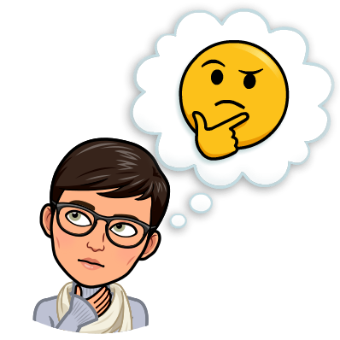
Wednesday 11/28/2018
Homework: Study Guide, Finish Learning Lotus
Warm up: What are the female parts of the flower? What is their purpose?
Agenda: Finish Learning Lotus (6 points total, classwork grade)

Slide 4
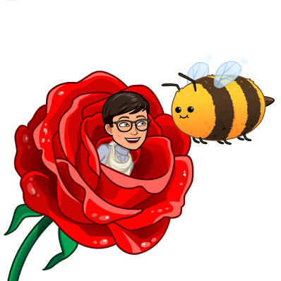
Thursday 11/29/2018
Homework:
Study Guide (up to Photosynthesis)
Warm Up:
None (we will do one TOMORROW instead)
Agenda: Flower Dissection
(lab AND lab write up are due
at the end of class!

Slide 5
Friday 11/30/2018
Homework: None
Warm Up: What is the difference between pollination and fertilization?
Agenda:
Pollination Lab (group of 3 people)
Go over Rocks, Weathering and erosion test results

Slide 6
Pollination is when a pollinator brings pollen from an anther to the stigma. The pollen tube grows down the style and reaches the ovary.
Fertilization- When the pollen fertilizes the ovules, turning them into seeds.

Slide 7
Monday 12/3/2018
Homework: Study Guide
Warm Up: During the pollination lab, what did the Q-Tip represent? What did the cotton balls represent?
Agenda:
Accessory Plant parts notes
Working Lunch today for test retake
Rocks, Weathering, Erosion and Soils retake tomorrow during lunch, after school Tuesday and Wednesday (YOU MUST SIGN UP)
If you cannot stay after, you need to make arrangements with me.

Slide 8
Tuesday 12/4/2018
Homework: Study for Soils test retake OR Plants test. Complete study guide questions about photosynthesis and cellular respiration.
Warm Up: What are the little holes on the underside of leaves called? What is their function?
Agenda:
Soil Conservation stuff to study for test retake
Photosynthesis and Cellular Respiration Cornell Notes

Slide 9
Wed. 12/5/2018
Homework: Study! Make sure you KNOW all the parts of the flower and their functions as well as the difference between Xylem and Phloem
Warm Up: What is the chemical formula for photosynthesis? What are the reactants? What are the products?
Agenda: Bill Nye Plants

Slide 10
6CO2 + 6H2O=> C6H12O6 + 6O2

Slide 11
Thurs. 12/6/2018
Homework: Plickers Quiz tomorrow, P/CR table and Exit Ticket (if not finished)
Warm Up: Nettles, thorns,and spikes are all examples of what kind of plant adaptation?
Agenda: P/CR Cornell Notes (Google Classroom)
P/CR table and Exit Ticket (Science Voyages p.244)

Slide 12
Friday 12/7/2018
Warm Up: NONE
Homework: NONE (study for your test on Friday maybe….)
Agenda:
Plickers Quiz
Go over P/CR compare and contrast/ Exit Ticket
Transpiration video and notes https://youtu.be/mc9gUm1mMzc

